Slide 1
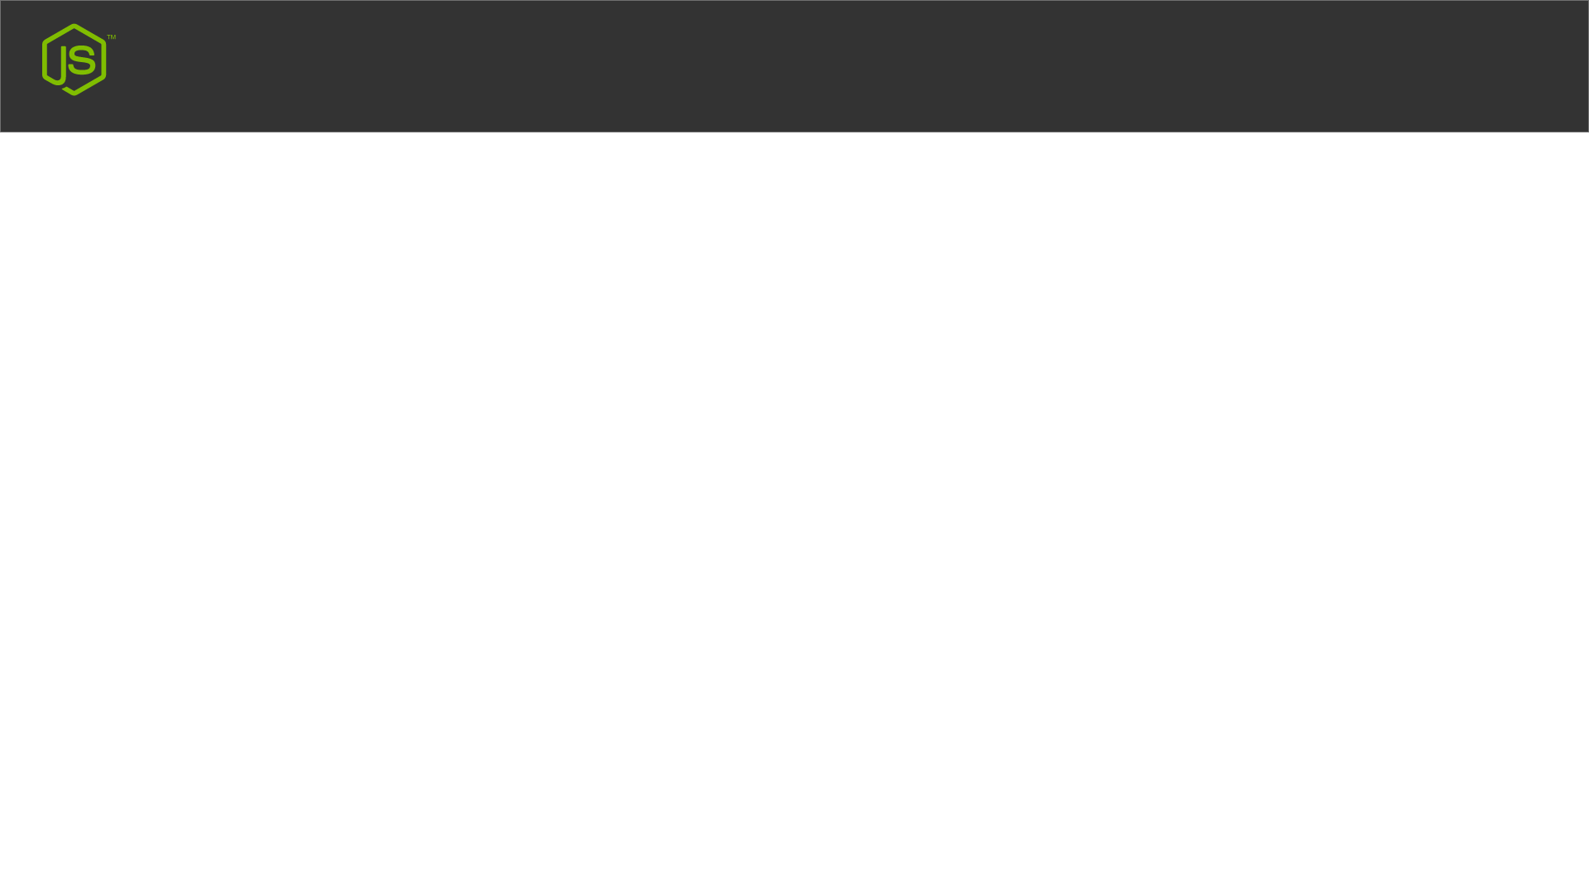
Terminal
TOOLS
Node.js
VS Code
WebStorm
TERMINAL
Windows CMD
Windows PowerShell
VS Code Terminal Option
WebStorm Terminal
Node JS Terminal

